Slide 1
South Carolina DOT Training Workshop Geophysics Field Testing Methods, Data Reduction, and Interpretation of Results
Robert C. Bachus and Glenn J. Rix
June 5 – 26, 2020

Slide 2
Suspension Logging

Slide 3
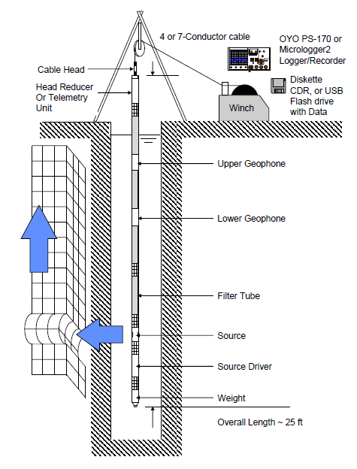
Suspension Logging
Fluid-Filled
Borehole
Uncased is strongly preferred
Triaxial
Receivers
Δz
Shear and Compression
Waves
Source
OYO P-S Suspension Logger

Slide 4
Borehole Geophysical Logging
Sonic (acoustic) logging
e.g., Pickett, G.R. (1963). “Acoustic character logs and their applications in formation evaluation,” Journal of Petroleum Technology, 15(6), 659-667, DOI: 10.2118/452-PA
Full waveform sonic logging
Cheng, C.H., and Toksoz, M.N., (1981). “Elastic wave propagation in a fluid-filled borehole and synthetic acoustic logs,” Geophysics 46, 1042, DOI:10.1190/1.1441242
Paillet, F.L., and Cheng, C.H. (1991). Acoustic Waves in Boreholes, CRC Press, Boca Raton, 176 pp.
Tang, X.-M., and Cheng, A. (2004). Quantitative Borehole Acoustic Methods, Handbook of Geophysical Exploration: Seismic Exploration, Vol. 24, Helbig, K., and Treitel, S., Eds. Elsevier, Amsterdam.
Suspension logging
Ohya, S., Ogura, K., and Imai, T. (1984). “The suspension PS velocity logging system,” Proceedings, Offshore Technology Conference, Houston, TX, May, DOI: 10.4043/4680-MS

Slide 5
Suspension Logging
Geophysical Service Companies
Schlumberger
Baker Hughes
Robertson GeoLogging
Reeves Wireline, Inc.
etc.
Geotechnical Testing
OYO Suspension Logger
GEOVision Geophysical Services, Inc.
Mount Sopris Instruments

Slide 6
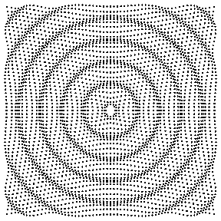
Suspension Logging
Monopole source
Useful only in “fast formations” with V_{s,soil} > V_{p,fluid} because shear waves are critically refracted at the interface between the borehole fluid and surrounding formation (i.e., soil or rock)
https://www.acs.psu.edu/drussell/Demos/rad2/mdq.html

Slide 7
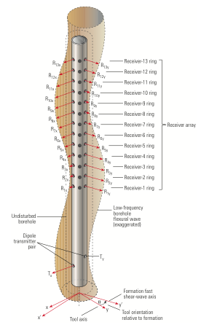
Suspension Logging
Dipole source
Useful in “slow formations” with V_{s,soil} < V_{p,fluid} because shear waves are directly generated in the formation via a bending or flexural mode of vibration of the borehole
Note: Multiple receivers
https://www.acs.psu.edu/drussell/Demos/rad2/mdq.html
Holdorsen et al., (2006)

Slide 8
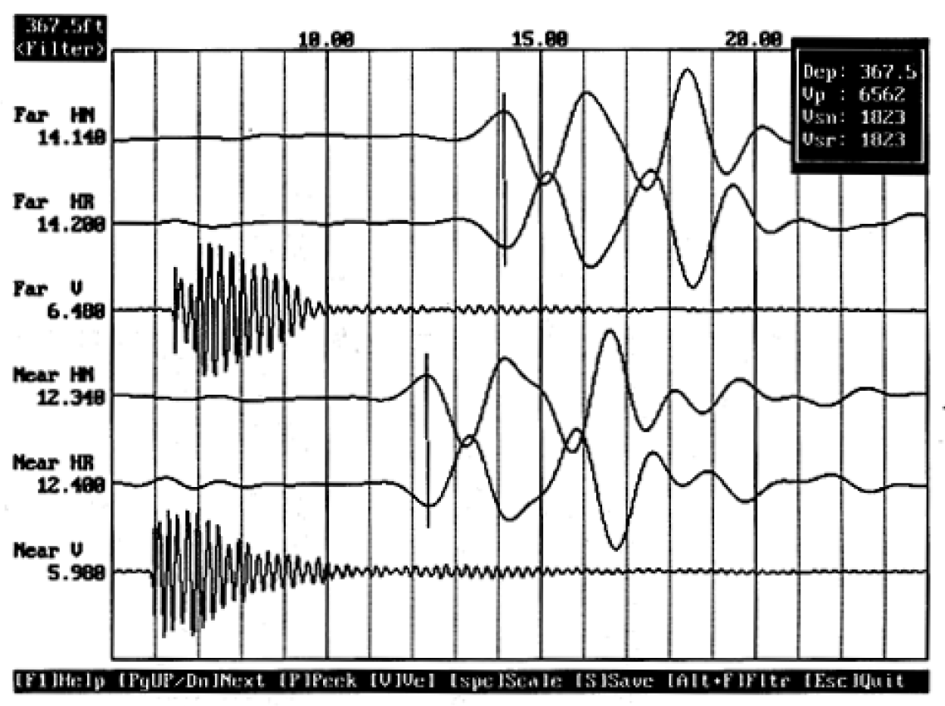
Suspension Logging
First peak
$$V_{sr}=\frac{\text{3.28 }\text{ft}}{\text{14.2 −12.4 }\text{msec}}$$
= 1823 ft/sec

Slide 9
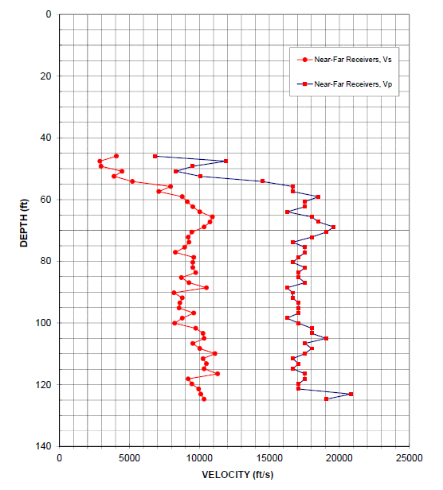
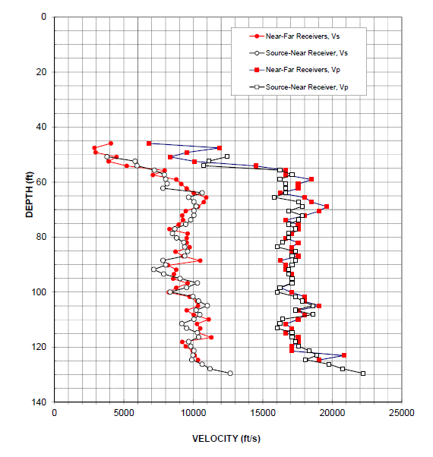
Suspension Logging

Slide 10
Suspension Logging

Slide 11
Suspension Logging
Strengths
Ideal for deep profiling
Requires a single borehole
Excellent resolution; typically 1.5 to 3 ft
Compression and shear wave measurements obtained simultaneously
Geotechnical applications can leverage extensive development and experience for resource exploration applications
Limitations
Proprietary nature of geotechnical applications
Limited number of geotechnical vendors

